Slide 1
Instructor’s Guide
This slide deck is designed to be used four-hour hands-on course
Four 50 minutes lecture with lots of hands on time
Encourage students to type examples
10 minute beaks between sessions with questions
15 minutes for questions that the end of the session

Slide 2
Typical timing
Introduction (50 minutes)
Review of Docker
Clinical Focus
Running TigerGraph in Docker
Graph Studio
The LPG data model
Break – 5 minutes
Modeling Guidelines (50 minutes)
RDBMS to Graph
Properties
Break – 5 mintutes
Loading Data (45 minutes)
GUI
Giraffle DSL
Querying Data (30 minutes)
GSQL shell
Builtin Queries
GSQL
Algorithms (30 minutes)
Overview of algorithms types
Similarity
Entity resolution
Patients Like Me
Reusing Graph Data
Health System Platform

Slide 3
Workshop – Graph Databases
Dan McCreary
Sudeep Vishnumurthy
Josh Meekhof
June 26th, 2019

Slide 4

Graph Databases for Healthcare
DRAFT Version 1.0
Last Updated December 2018
Dan McCreary
Distinguished Engineer
Advanced Technology Collaborative
Sudeep Vishnumurthy
Senior Principal Engineer
Enterprise Enablement and
Platform Services
Josh Meekhof
Senior Principal Engineer
Advanced Technology Collaborative
Notes:
Hi – my name is Dan McCreary. I am a Distinguished Engineer working in the Advanced Technology Collaborative. I am leading the graph technologies initiative within the Advanced Technology Collaborative. Our goal is to build a collaborative community the use graph technology to lower the cost of healthcare and give Optum a competitive advantage in the marketplace.

Slide 5
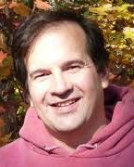

Welcome!
Dan McCreary
Distinguished Engineer
Advanced Technology Collaborative
Sudeep Vishnumurthy
Senior Principal Engineer
Enterprise Enablement and Platform Services
Josh Meekhof
Senior Principal Engineer
Advanced Technology Collaborative
Notes:
My background is a solution architect. I have spent most of the last 20 years understanding how to objectively match business problems to the appropriate technologies. My focus has been on the fast-evolving area of NoSQL databases. I have also had a strong interest in AI, semantics, natural language process and search. I have been working on challenges problems in C360 and Benefit Search for over four years within Optum.

Slide 6
Prerequisites
Goal: use Developer Days for hands-on instruction
Everyone should have taken the LearnSource course on Introduction to Graph Databases
Everyone should have at two Docker images on their desktop:
TigerGraph base image (TigerGraph 2.3.2)
Image that includes synthetic clinical data
Clone https://github.optum.com/ATC/graph-training/tree/master/modeling
Run the docker_compose command in the README.md

Slide 7
Learning Objectives
After this course students will be able to:
Understand how to use Docker to run TigerGraph on your desktop or a virtual machine
Understand how to use the TigerGraph GraphStudio tool to create a graph model
Understand the components of a Labeled Property Graph (LPG)
Understand the modeling tradeoffs of using various LPG components
Understand a sample data model for a clinical setting
Understand the Synthea synthetic clinical systems
Understand the process of converting relational and tabular data into an LPG
View sample geospatial and temporal models
Learn about gradle and Giraffle for consistent data loading
Learn about the GSQL query language
Learn about graph algorithms
Find out how to learn more about graphs and join the Optum graph community

Slide 8
Sample Dependency Graph
Teaching a
Graph Class
Depends On
TigerGraph
Docker Image
16GB
Desktop
Depends On
Budget Code
AskID
Depends On
Mac
Docker
Windows 10
Docker
Depends On
VM
PulseSecure
Bug Fix
PulseSecure
Installer
Depends On
Finish
PulseSecure
Installer Testing
Depends On

Slide 9
GUI vs Command Line
Graphical User Interface (GUI)
Command Line Interface (CLI)
Good for learning
Good for viewing the status of what is in Docker or Tigergraph
Don’t have to remember commands
Difficult to reproduce
Recommendation
Use the GUI for the first two weeks – then use gradle-based tools (Giraffle) for reproducible results on multiple platforms
Great for scripting
Required for remote systems
Highly reproduceable
Requires you to learn and remember commands
Perfect for different environments
DEV, TEST, STAGE, PROD

Slide 10
Why Graph for Healthcare
Lecture

Slide 11
Optum is in Transition
Today (Legacy)
Future (Goals)
Batch Claims Analytics
On Site RDBMS Vendors
Claims, Member, Provider
Silos of Data
Streaming (Kafka)
Diverse open source and cloud mix
Full Clinical
Individual Healthcare Record (IHR)
Clinical Decision Support (CDS)
Real-Time Point-of-Care
Accountable Care Organization (ACO)
Integrated Knowledge Graph

Slide 12
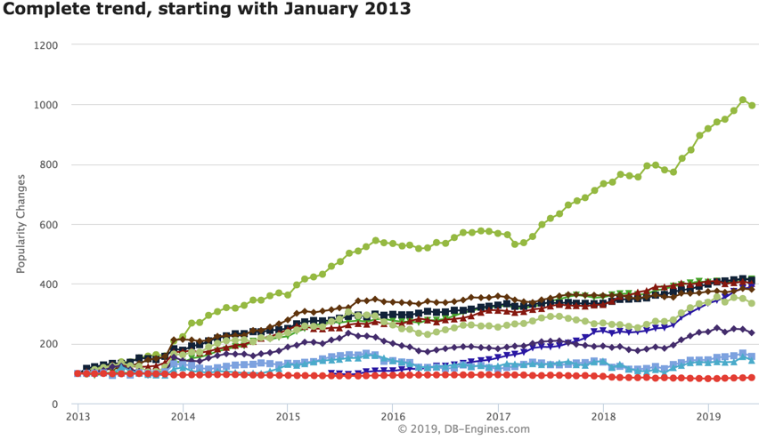
Graph Databases are HOT!
Graph Databases
https://db-engines.com/en/ranking_categories
Notes:
This chart shows the relative change in popularity of graph databases compared to other technologies according to DB Engines. DB Engines has web crawlers that regularly harvest an classify data related to databases. You can see that Graph Database popularity is the fasting growing database technology. This trend started in 2013 and it is continuing strong in 2018. Note that is is not absolute popularity. This is the change is popularity. Popularity also does not imply suitability. However, with these disclaimers aside you can clearly see a sustainable trend. Let’s see what other evidence we have about the rise of graph technologies.

Slide 13
The “Achilles Heel” of Native Graph Databases
RAM
RAM
If all nodes and arcs don't fit into RAM memory performance will quickly degrade. A challenge for shared-nothing architectures. Distributed graphs have excellent scale-out characteristics.
RAM full limit
Graph
Traversal
Performance
AWS has a single server that has 12TB RAM and 443 cores for $30/hr
No Disk Swap
Disk Swap
Graph Size
Notes:
A native graph is ideal when your entire graph, every node, relationship and their properties, all fit into the RAM of a single computer. But what happens if the size of your graph exceeds the amount of RAM on your single computer? The result is that graph traversal performance, the number of nodes you can traverse is a second, drops dramatically. This is due to the fact that your computer will need to go out to slower memory access, like SSD or spinning disk, to bring data in for analysis.
Our challenge is that graph traversal is often unpredictable. You often cannot partition your data to put a subgraph in RAM.

Slide 14
Graph Technology Relationships
Optum
Blockchain
Security
IHR
Trust
AI
IoT
Edge
Computing
Smart
Contracts
Algorithms
Data Structures
Machine
Learning
Inference
Knowledge
Representation
Graph
RDF
Semantics
Neural
Networks
Fact Extraction
Rules
Taxonomies
Real Time
Deep
Learning
Natural
Language
Processing
Ontologies
IHR
Clinical
Decision
Support
Genomics
IHR

Slide 15
When to Use Graph
https://medium.com/@dmccreary/a-taxonomy-of-graph-use-cases-2ba34618cf78

Slide 16
Graphs work well on high-variability data
Low Variability
High Variability
General Ledger (GL)
Claims
Drug Interactions
Clinical Data
Invoice
Benefit Plans
360 Applications
Star Rating
Shopping Cart
Providers
Genomics
Data Hubs
Most business systems fit somewhere on a spectrum of data variability
Highly regular systems, like a GL have low variability
Variability tends to grow over time as exceptions are introduced to a system
Few real world systems can accurately predict

Slide 17
Graph and Clinical Data
Graph databases are ideal for storing clinical data
Clinical data is both complex and has high variability
Strong real-time analytical performance at scale is needed for real-time clinical decision support
Graph algorithms like Cosine Similarity are ideal at ”Patients Like Me” queries
Graph
Clinical
Data

Slide 18
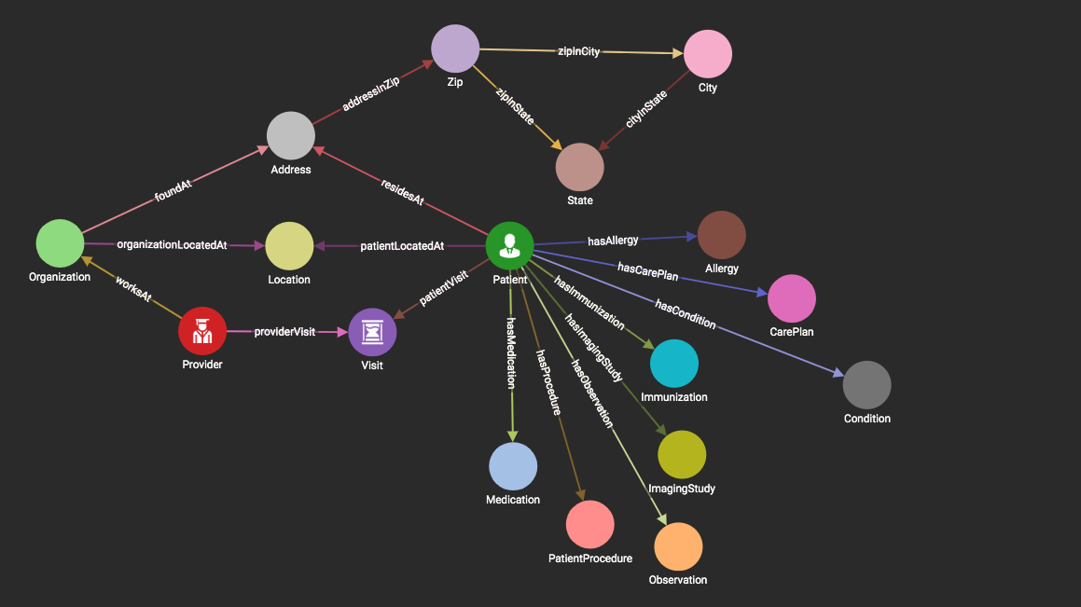
Our “Simplified” Clinical Model
17 verticies

Slide 19
15 of 21 Andrew Witty Strategies Involve Graph Technologies
Clinical Expertise
Integrated, Holistic Health Data (IHR)
Clinical Insights Across Care Continuum
Application Route
Benefit Alignment
Benefit Alignment
Financial Accountability
“Smart” Clinical Guidance System
Care Assets
Health System Development
Consumer Front End
Consumer Experience
Big Data Environment
Consumer Platform
Price Transparency, Scheduling
Consumer Experience (continued)
Payment and Financial Services
Benefit Augmentation
Condition Specific Management
Big Data Environment
Patient Engagement/Monitoring Tools
Customized and Dynamic Care Plan
Services Ecosystem
Embedded Technology
Big Data Environment
Transaction Processing Marketplace
Care Navigation and Administration
Graph related projects are in Orange

Slide 20
Graphs and the “Open World Assumption”
Past: Closed Word
Graph: Open World
CLOSED!
Everything is prohibited until it is permitted
You can only add data that you model
Everything is permitted until it is prohibited
Anyone can easily add any data at any time without disruption of services
Notes:
There is another way to describe the differences between fixed and schema agnostic. This is related to the way that logic systems make assumptions about unknown data. Many relational database use logic that imply that missing or unknown data is always false. Graph databases use an assumption that unknown data is usually unknown. This is known as the Open World Assumption (OWA).
https://en.wikipedia.org/wiki/Open-world_assumption
http://www.mkbergman.com/852/the-open-world-assumption-elephant-in-the-room/
Technically, both Neo4j and TigerGraph require models for their verticies and edges although they are easy to change.

Slide 21
Definition: Graph Databases
A database that uses verticies (node) and edges (relationships) as atomic units of storage and where fast graph traversal is the primary method of accessing information.
Vertex
Vertex
EDGE
In graph databases, relationships are a primary consideration.
Notes:
Lets define what we mean by nodes and edges. Graph databases really have two fundamental units of storage: the vertex (or node) – which are usually the Nouns (People, Places and Things) and edges (or relationships) – which are the relationships between our vertecies. In some types of graphs, nodes and edges each can have their own properties. In graph databases, relationships are the primary consideration.

Slide 22
Relational vs. Graph
Relational (row store)
Graph
ID
NAME
DATE
AMOUNT
Atomic unit of storage is a row of a table and data is appended to a table one row at a time
All columns within a table must have the same datatype
Table structures are fixed after design – adding a new field for a single row is difficult
Relationship traversal is done via JOINs at runtime using log(N) search’s calculated at query time
Difficult to distribute over a cluster of 100+ nodes
Atomic unit of storage are nodes, edges and properties
Each node and edge may have independent properties that are determined at run time (schema agnostic)
Joins between nodes and edges are computed at load time and are stored as memory pointers
Relationships traversal is done using pointer hopping – each core can evaluate 2M hops per second
Distributed graph products are new
Notes:
Now lets do a side-by-side comparison of both the traditional Relational row-store and compare some key facts. With a row store, the atomic unit of work is adding a single row at a time to a table. The key is that all the datatypes in each column must be the same. If there are dates in the third column and decimals in the fourth column all your data must conform to this standard. The table column structures and datatypes are fixed when you design your database. Once you have a million rows loaded into each table and 10,000 reports created it becomes challenging to modify the database.
Relational database also use the SQL language and they use join operations to dynamically calculate relationships each time the query is run. These calculations are based on binary search algorithms that run in log(N) time where N is the number of rows in each table. As the table grows the searches sale as the log of the number of rows.
Graph databases on the other hand allow you to add any number of nodes and and relationships into your graph database. Each node and relationship has it own properties but there are usually few overarching rules about what datatypes these structures can contain. Graph databases also used fixed memory pointers to store relationships between each node. As a result the queries over relationships are fast and there is no slow-down as the number of verticies gets bigger.

Slide 23
Local vs. Distributed Graphs
Local Graph
Distributed Graph
Data Node
Data Node
Query and Data
Query Node
Data Node
Data Node
Data Node
Queries run on a single local node.
All codes assumes a flat local memory
Easy to make ACID compliant
Queries are distributed over a large cluster of nodes and the results returned and consolidated (like MapReduce)
Query distribution is handled by the database
Complex to write – requires MVCC

Slide 24
Running Docker
Hands On

Slide 25
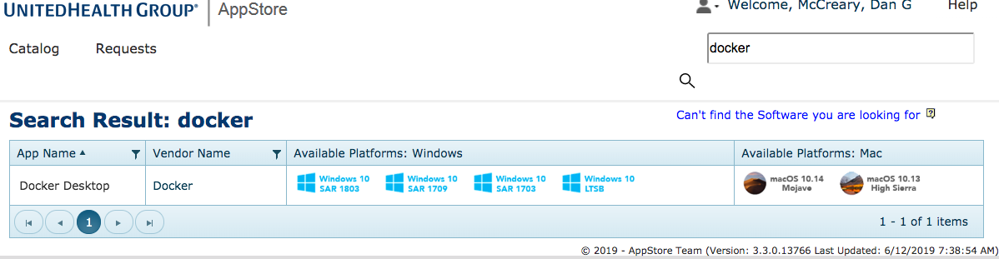
Docker Desktop Installation Summary
Available from the AppStore for both Mac and Windows
Go to http://appstore.uhc.com
Search for “docker”
Requires latest version of PluseSecure on Windows

Slide 26
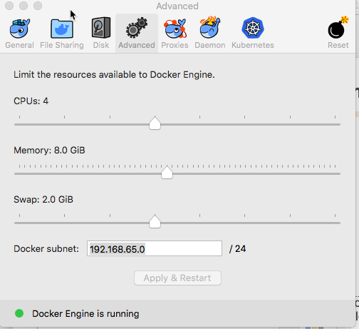
Change the Docker Default RAM and SWAP Limit
This step is frequently forgotten by our users

Slide 27
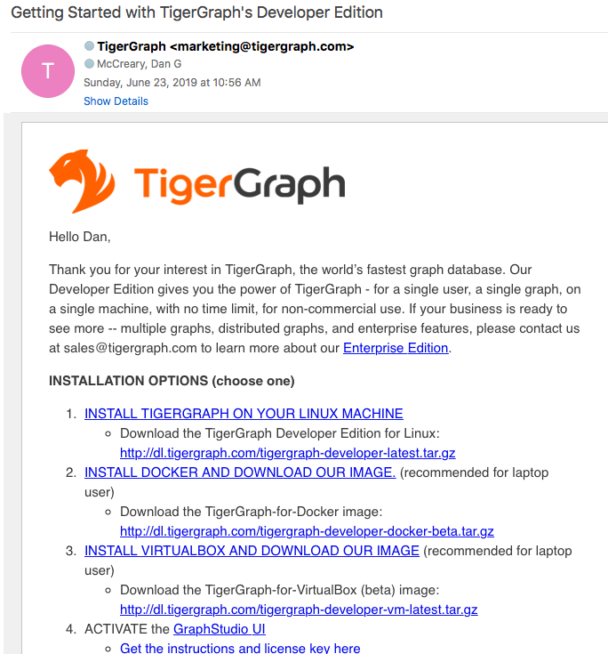
Incoming E-mail from TigerGraph
Use Option #2 - INSTALL DOCKER AND DOWNLOAD OUR IMAGE. (recommended for laptop user)
Download the TigerGraph-for-Docker image:
http://dl.tigergraph.com/tigergraph-developer-docker-beta.tar.gz
Image is 1.4GB!
20 minutes from home cable modem

Slide 28

https://info.tigergraph.com/docker-tigergraph
Includes tips for mounting local volumes for making data loading easier.

Slide 29
TigerGraph Developer Base Docker Image
TigerGraph Developer is required for this course
It is suggested you run it on your local desktop
Register at: https://www.tigergraph.com/developer/
Once the Docker zip has been downloaded then run the following command
“docker load -i tigergraph-developer-latest-docker.tar.gz”
Once the images have been loaded you can do the docker run with the options discussed next
“docker run….[OPTIONS]”
There should next be an interactive instance of the TigerGraph client running as well as an instance of the TigerGraph server.
Once the TigerGraph Server has been initialized, please open a browser and proceed to “localhost:4142” to start using TigerGraph Studio

Slide 30
Transcript of Docker image being loaded from gz file
mac$ docker load -i tigergraph-2.3.2-developer-docker-image.tar.gz
aa54c2bc1229: Loading layer [==================================================>] 121.6MB/121.6MB
7dd604ffa87f: Loading layer [==================================================>] 15.87kB/15.87kB
2f0d1e8214b2: Loading layer [==================================================>] 11.78kB/11.78kB
297fd071ca2f: Loading layer [==================================================>] 3.072kB/3.072kB
9f86e80e2912: Loading layer [==================================================>] 4.096kB/4.096kB
3a3823c9b97e: Loading layer [==================================================>] 3.556GB/3.556GB
9bd5cb8282d6: Loading layer [==================================================>] 337.9kB/337.9kB
Loaded image: tigergraph:2.3.2
Loaded image: tigergraph:latest
The file tigergraph-2.3.2-developer-docker-image.tar.gz is about 1.4GB – no need to uncompress
This script should run in under five minutes on a Mac with 16GB RAM and 8GB configured to run Docker

Slide 31
Docker Run with Volume Mount
$ docker run -i -t --name tigergraph2.3.2
--mount type=bind,source='/Users/dmccrea1/tg',target='/home/tigergraph/data’
-p 4142:14240
-p 9000:9000 tigergraph:2.3.2
The mount option on a docker startup allows you to copy sample data files (CSV, JSON etc.) to a local file system (/Users/dmccrea1/tg) and then run a GSQL load script from within your Docker container that reads file files from the mounted files that appear with the /home/tigergraph/data within the docker container
Note that you can’t easily run the mounts after the Docker image is running. This should be done from the UNIX shell when you run your Docker image.

Slide 32
Full Docker Run Command
$ docker run -i -t
--ulimit nofile=1000000:1000000
--name tigergraph2.3.2 --mount type=bind,source='/Users/dan/tg',target='/home/tigergraph/data’
-p 4142:14240
-p 9000:9000 tigergraph:2.3.2
Run tigergraph in Docker using the existing tigergraph2.3.2 image

Slide 33
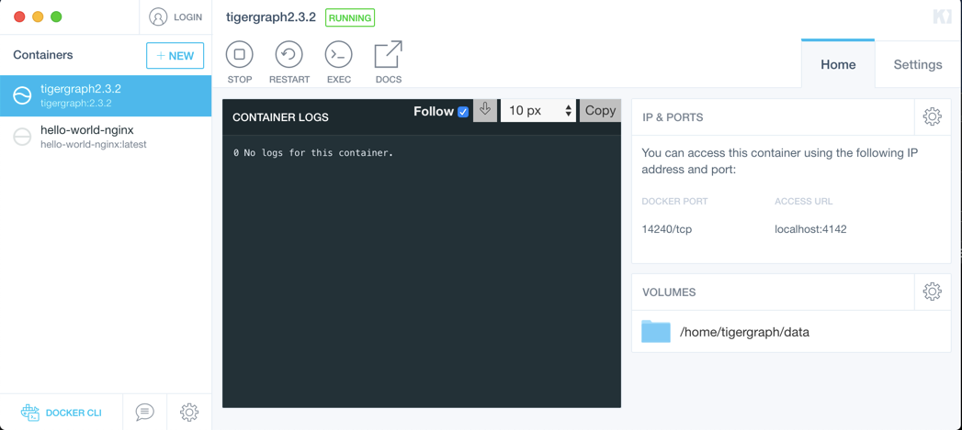
Sample Docker Kitematic for TigerGraph
Notes:
Five key areas:
Container Listing showing TigerGraph image
Current image is RUNNING
Controls for stoping, restarting, opening a shell and getting documentation
Ports
Volume – where to look for your data files

Slide 34
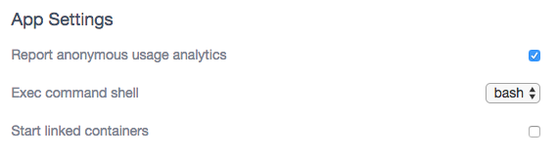
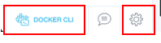
Recommendation: Start bash (not sh)
bash-3.2$ docker --version
Docker version 18.09.2, build 6247962
bash-3.2$ which docker
/usr/local/bin/docker
bash-3.2$ docker images
REPOSITORY TAG IMAGE ID CREATED SIZE
tigergraphclient latest 831d811fc46d 9 days ago 218MB
tigergraphserver OptumLatest 9f4ec5b99078 10 days ago 3.68GB
docker.repo1.uhc.com/graphtraining/modelingclient latest 316af2f1ff92 2 weeks ago 217MB
docker.repo1.uhc.com/graphtraining/modelingserver latest 066756d7db2f 3 weeks ago 4.33GB
docker.repo1.uhc.com/graphtraining/tigergraph latest 5c3100478b6d 2 months ago 3.63GB
cambridgesemantics/anzograph latest 9d3534f6423 4 months ago 2.95GB
tigergraph 2.2.3 e1911655f9a7 7 months ago 4.11GB
dgraph/dgraph latest 131f6dd60be6 9 months ago 132MB
neo4j 3.4.1-enterprise c1175f4ec25e 11 months ago 208MB

Slide 35
Useful Docker Commands
General Docker Commands
Docker IMAGE Commands
docker help
docker version
docker info
docker images – list images
docker ps – see what is running
docker run [IMAGE]
Docker CONTAINER Commands
docker start [CONTINER]
docker stop [CONTINER]
docker restart [CONTINER]
docker rm [CONTINER]

Slide 36
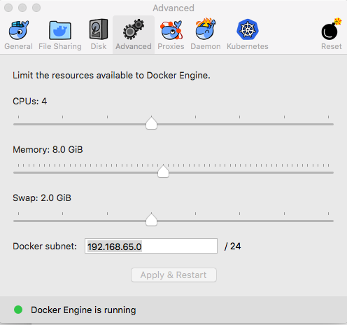
Check your Docker Memory
$ docker info
Containers: 15 Running: 3 Paused: 0 Stopped: 12
Images: 29
Server Version: 18.09.2
Network: bridge host ipvlan macvlan null overlay
Kernel Version: 4.9.125-linuxkit
OSType: linux
Architecture: x86_64
CPUs: 4
Total Memory: 7.786GiB
$ docker info | grep Memory

Slide 37
Notes on Starting and Stopping Docker
For the TigerGraph Base Image (one container) you can start and stop the container using the Kitematic GUI or the shell
For the Tigergraph Clinical demo you MUST start the containers using the docker_compose UNIX shell command:
$ cd tigergraph-training/modeling
$ docker-compose run tigergraph_client
The docker-compose will look for the right docker-compose.yml file
Note that you can stop both containers from the Kitematic GUI

Slide 38
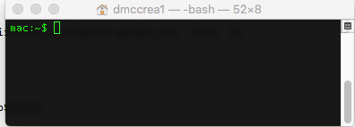
TigerGraph Clinical Labs
TigerGraph
Client
TigerGraph
Server
Gradle
GSQL client
200MB
TigerGraph Server
Data Files
3GB
There will be two Docker images running
The standard server that has clinical data and labs ready to load
A very small client with just gradle and the GSQL client libraries
You connect your terminal to the TigerGraph Client (Exec)

Slide 39
Docker.compose.yml file
version: '3.4'
services:
tigergraph_server:
networks:
- gateway
image: docker.repo1.uhc.com/graphtraining/modelingserver:latest
container_name: modeling_server
tty: true
stdin_open: true
ports:
- "4142:14240"
tigergraph_client:
container_name: modeling_client
image: docker.repo1.uhc.com/graphtraining/modelingclient:latest
depends_on:
- tigergraph_server
networks:
- gateway

Slide 40
TigerGraph Base Image
Hands On

Slide 41
Run a Bash Shell on Tigergraph
mac$ bash -c "clear && docker exec -it tigergraph2.3.2 bash"
$ echo $SHELL
/bin/bash
$ whoami
tigergraph
$ gsql
Welcome to TigerGraph Developer Edition, for non-commercial use only.
GSQL-Dev > ls
---- Global vertices, edges, and all graphs
Vertex Types:
- VERTEX Patient(PRIMARY_ID Id STRING, FirstName STRING, LastName STRING, Prefix STRING, Suffix STRING, MaidenName STRING, MaritalStatus STRING, Gender STRING, Race STRING, Ethnicity STRING, DateOfBirth DATETIME, DateOfDeath DATETIME DEFAULT "32503593600", SSN STRING, DL STRING, Passport STRING) WITH STATS="OUTDEGREE_BY_EDGETYPE"

Slide 42
Graph Development Steps
Create Model – verticies, edges, properties
Create Maps – create mappings between CSV files and vertices and edges – maps are stored in “load jobs”
Execute Loads – run a task that will load the CSV data into the graph using the maps
Explore Graph – use the GUI tool to view the data you have loaded
Run Queries – create and compile queries

Slide 43
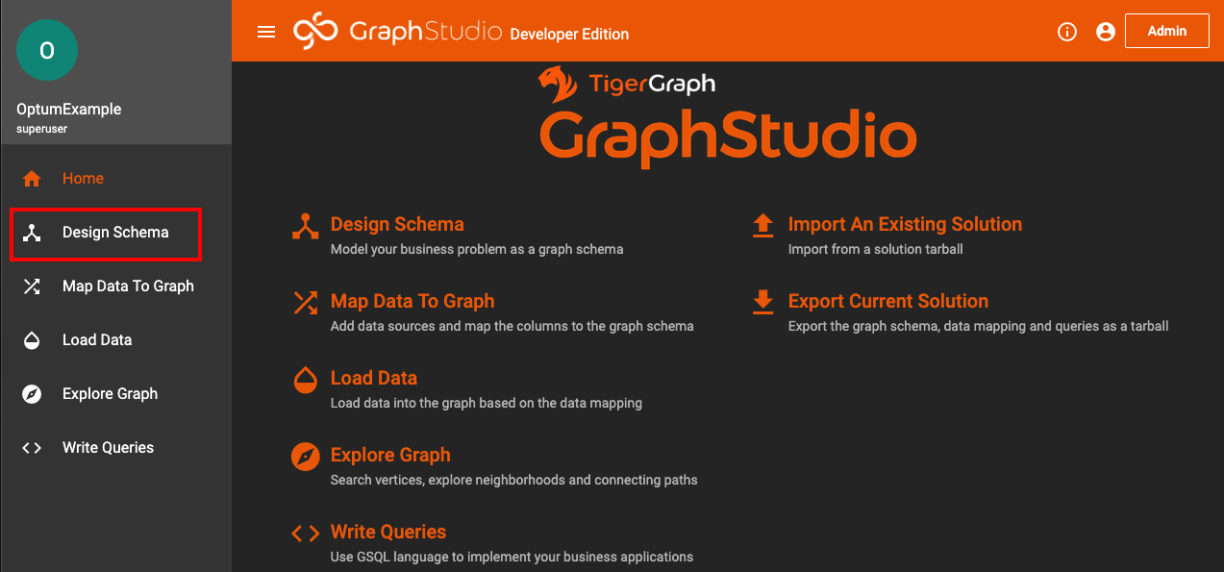
Design Schema TigerGraph Studio
Once an instance has been initiated the Tigergraph Studio will be used for this section to create vertices and edges through the UI
The first action is to start designing a schema for the clinical domain

Slide 44
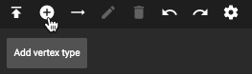
Design Studio Toolbar
Hover over each icon to see what it does

Slide 45



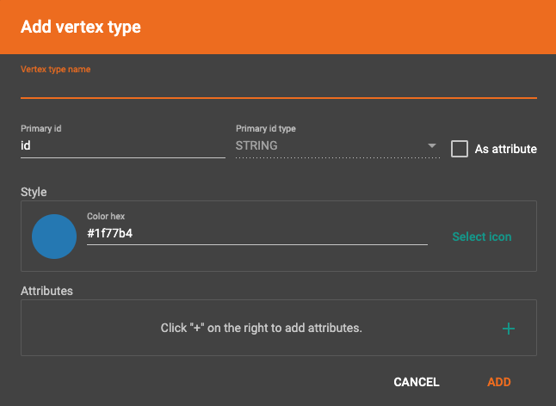
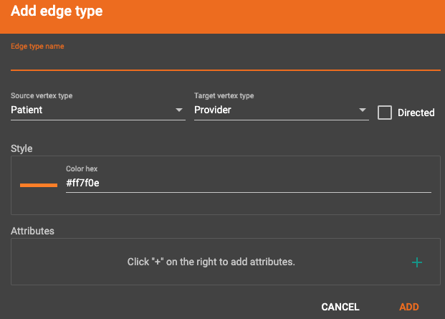
Creating Nodes, Edges and Graphs in TigerGraph
Creating a Vertex Type
Click on add vertex
Fill out properties for the vertex type
To create an edge click on a vertex and click on add edge
Fill out properties for the edge type
After vertices and edges have been added click to create graph or publish the schema
For the course everyone has their own TigerGraph instance, but when working in a shared environment publishing would impact everyone using the shared instance

Slide 46
Graph Naming Conventions
Verticies – Upper Camel Case
Properties (Attributes) – Lower Camel Case
End with ISO representation term (Name, Date, ID, Code, Amount)
Relationships – All uppercase with underscores

Slide 47
Think about the relationship between a provide and a patient
Provider
?
Patient
Start with the simple case of providers and patients
How are these two concepts typically related?
How would you describe the relationship? Can you name it?
Does the relationship have direction?
Are there intermediate relationship nouns?

Slide 48
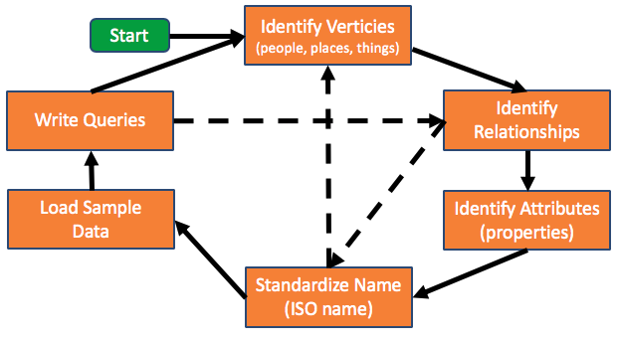
Graph Modeling is an Iterative Process
All models are wrong…some are useful.

Slide 49
Modeling Guidelines
Nouns become verticies
People, places and things
Things that describe the things become properties of the verticies
Person: givenName, familyName, dateOfBirth
Relationships between nouns become edges
PATIENT_HAS_PROVIDER

Slide 50
Doctor and Patient Properties
Doctor
Patient
doctorID
givenName
familyName
specialty
patientID
givenName
familyName
birthDate
medicalCondition
firstVisitDate

Slide 51
Mapping Verticies
doctors.csv
patients.csv
doctorID,givenName,familyName,specialty
d1,Sue,Smith,Family Practice
d2,Brian,Adams,Acupuncture
d3,Peg,Sinclair,Family Practice
d4,Molly,Davis,Midwife
d5,Olivia,Jones,Obstetrics and Gynecology
d6,Craig,Soloman,Cardiologist
d7,Arun,Patel,Endocrinologist
d8,Berry,Boucher,Pediatrics
d9,Miriam,Olson,Family Practice
patientID,givenName,familyName,birthDate,medicalCondition
p1,Sue,Smith,1985-01-15,cold
p2,Brian,Adams,2000-01-15,flu
p3,Peg,Piasta,2001-01-15,back pain
p4,Molly,Davis,2000-01-15,prenatal visit
p5,Olivia,Jones,1990-01-15,concussion
p6,Riley,Appiah,2000-01-15,cut on arm
p7,Arun,Patel,2000-01-15,burise on foot
p8,Lewis,Boucher,1995-01-15,neck pain
p9,Miriam,Olson,1958-01-15,stress
Load these files into the mapper of Graph Studio

Slide 52
Mapping Relationships
doctor-patient-edges.csv
doctorID,firstVisitDate,patientID
d1,2000-01-15,p1
d1,2000-01-15,p2
d1,2000-01-15,p3
d1,2000-01-15,p4
d1,2000-01-15,p5
d1,2000-01-15,p6
d1,2000-01-15,p7
d2,2000-01-15,p1
d2,2000-01-15,p2

Slide 53
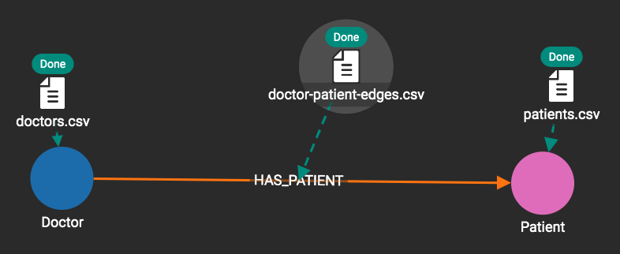
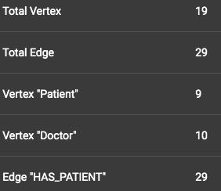
After Loading

Slide 54
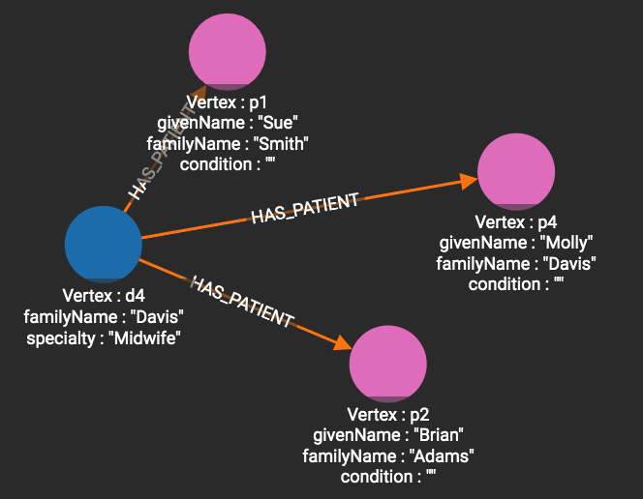
Results of Explore

Slide 55
Clinical Graph with Synthetic Data
Hands On

Slide 56
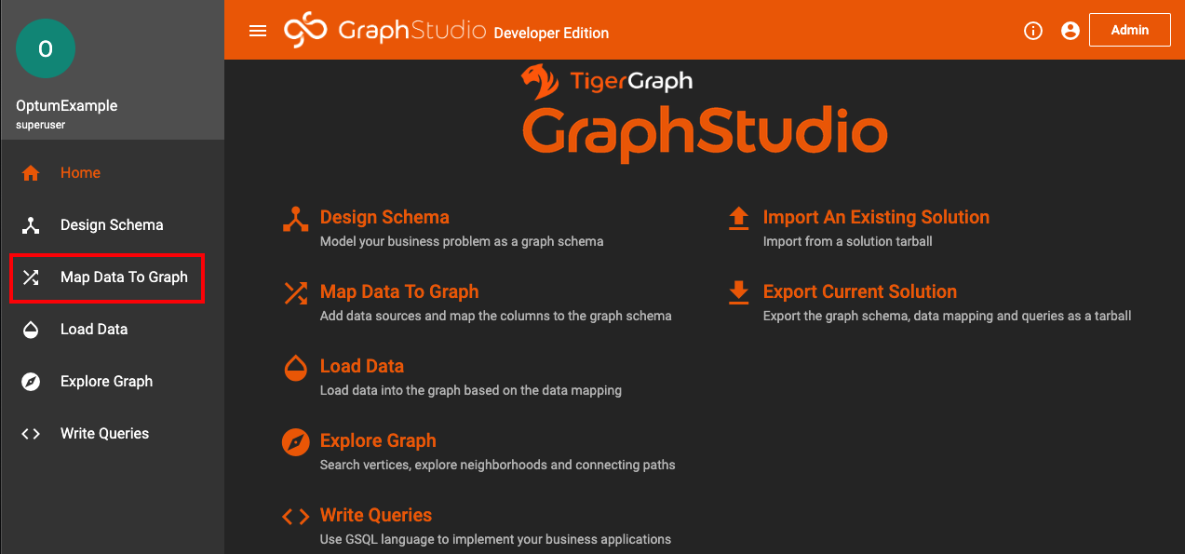
Mapping Data TigerGraph Studio
Now that the basis for a schema exists it is time to start populating the schema with data
Start by selecting “Map Data To Graph”

Slide 57
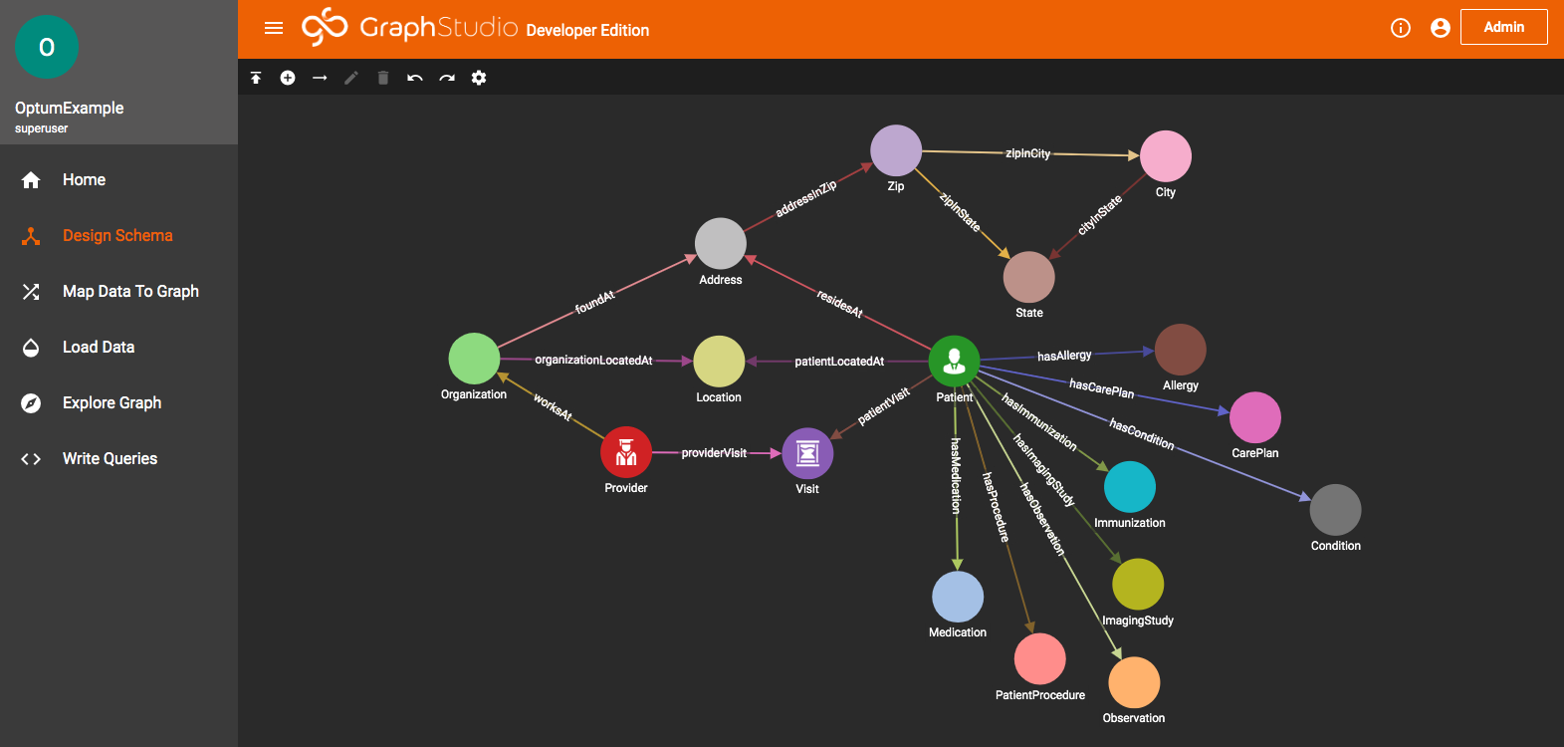

Slide 58
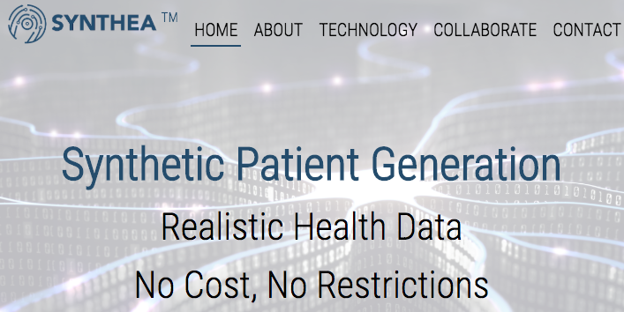
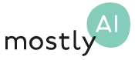
Synthetic Data
Synthea
Easy to use – one line shell command
Free open source synthetic patient generation
CSV and FHIR output
Closely matches our IHR model
https://synthetichealth.github.io/synthea/
Mostly AI
General synthetic data generation (not specific to clinical)
https://mostly.ai/
MedGAN
https://github.com/mp2893/medgan
Uses a generative adversarial network (GAN) to generate synthetic clinical data from real data that is statistically similar to actual data
Requires ML and GAN expertise
Requires detailed parameter tuning
Questions:
Jayanthi Suryanarayana

Slide 59
How to Run Synthea
$ cd workspace
$ git clone https://github.com/synthetichealth/synthea.git
Cloning into 'synthea'...
remote: Enumerating objects: 408, done.
remote: Counting objects: 100% (408/408), done.
remote: Compressing objects: 100% (270/270), done.
remote: Total 26998 (delta 207), reused 285 (delta 116), pack-reused 26590
Receiving objects: 100% (26998/26998), 434.89 MiB | 2.41 MiB/s, done.
Resolving deltas: 100% (15653/15653), done.
$ run_synthea -p 1000
{alive=1000, dead=177}
BUILD SUCCESSFUL in 2m 47s
Generates 1000 FHIR JSON Files

Slide 60
src/main/resources/synthea.properties
exporter.fhir.export = false
exporter.fhir_stu3.export = false
exporter.fhir_dstu2.export = false
exporter.fhir.use_shr_extensions = false
exporter.fhir.use_us_core_ig = false
exporter.fhir.transaction_bundle = false
exporter.fhir.bulk_data = false
exporter.hospital.fhir.export = false
exporter.hospital.fhir_stu3.export = false
exporter.hospital.fhir_dstu2.export = false
exporter.practitioner.fhir.export = false
exporter.practitioner.fhir_stu3.export = false
exporter.practitioner.fhir_dstu2.export = false
exporter.csv.export = true
FHIR Output
$ du -h output
1.1G output/fhir
CSV Output
$ du -h output
49M output/csv

Slide 61
Accessing the Clinical GSQL Shell
Shut down the Base TigerGraph server
Download the git repo from the graph-training/modeling course
Run the docker compose command
You should see a client bash shell come up
Note: you cannot restart the containers using Kitematic – you must use the shell docker_compse command which will be able to access the configuration file

Slide 62
Using GSQL Builtins to Count Verticies
SELECT count() FROM Patient
[{
"count": 1177,
"v_type": "Patient"
}]
SELECT count() FROM Provider
[{
"count": 105,
"v_type": "Provider"
}]
SELECT count() FROM Visit
[{
"count": 37936,
"v_type": "Visit"
}]
SELECT count() FROM Location
[{
"count": 1282,
"v_type": "Location"
}]

Slide 63
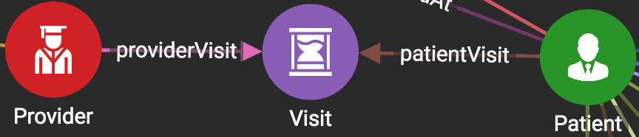
Selecting Edges

Slide 64
Count links from patients to visits
Patient
patientVisit
Visit
SELECT count() FROM Patient-(patientVisit)->Visit
[{
"count": 37936,
"e_type": "patientVisit"
}]
SELECT count() FROM Patient-(patientVisit)->ANY
Returns the same result

Slide 65
Exercise: How many allergies are there?
Patient
hasAllergy
*
SELECT count() FROM Patient-(hasAllergy)->ANY
[{
"count": 587,
"e_type": "hasAllergy"
}]
SELECT count() FROM Allergy
[{
"count": 15,
"v_type": "Allergy"
}]

Slide 66
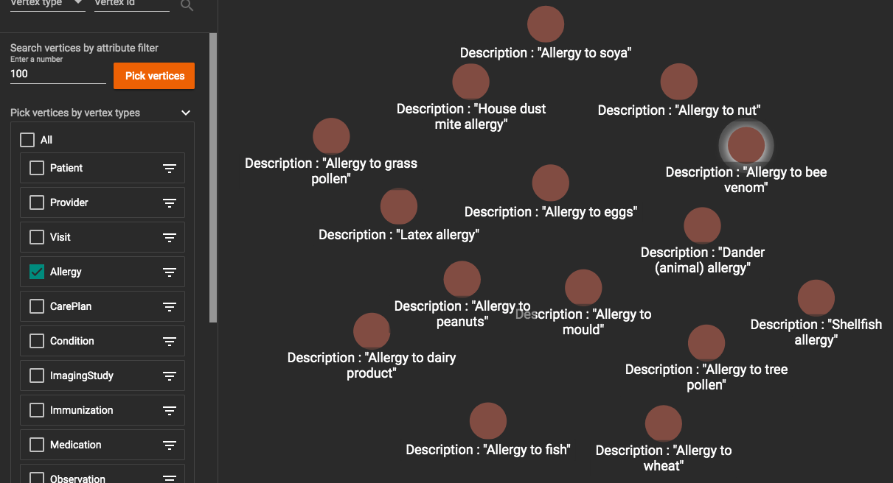
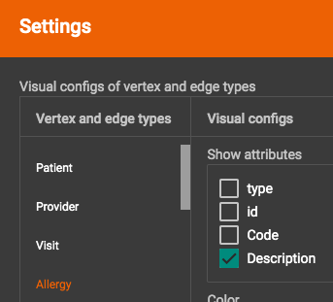
Show all Allergies
Unselect All
Select Allergy

Slide 67
GSQL
Hands On

Slide 68
Count the number of edges between patients and visits
SELECT count() FROM Patient-(patientVisit)->Visit
[{
"count": 37936,
"e_type": "patientVisit"
}]

Slide 69
GSQL Design Goals
Declarative
Allow developers to specify what they want without needing to think about how to get it
Keep the language simple to make it easy to parallelize
Only two basic primitives
Loops – SELECT-FROM-WHERE
Accumulators – bags, sets
Allow low-level optimization
User Defended Functions (UDFs) in C++
Both complied and interpreted modes of execution
Interpreted for iterative development

Slide 70
Recall MapReduce and Sort/Shuffle Key-Value Pairs
Programming distributed queries in the past was difficult
Programmers had to break queries into two steps (Map and Reduce) with a rigid key-value pair data structures between the steps
Simple queries were several pages of Java code

Slide 71
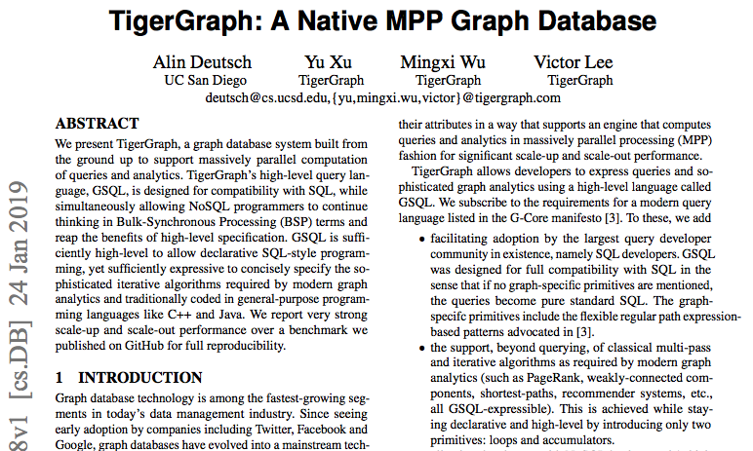
TigerGraph: A Native MPP Graph Database
https://arxiv.org/pdf/1901.08248.pdf

Slide 72
GSQL Scripts Are Distributed Native Graph Queries
data
data
data
data
data
Graph Storage Engines (GSE)
Graph Processing Engines (GPE)
data
GSQL
Query
data
data
data
data
data
GSQL is a distributed graph query language designed to be similar to SQL (declarative)
Distributed queries similar to MapReduce in that it works over a large clusters of computers
Queries are sent out to all data nodes in a cluster
Queries are executed and the results returned and aggregated

Slide 73
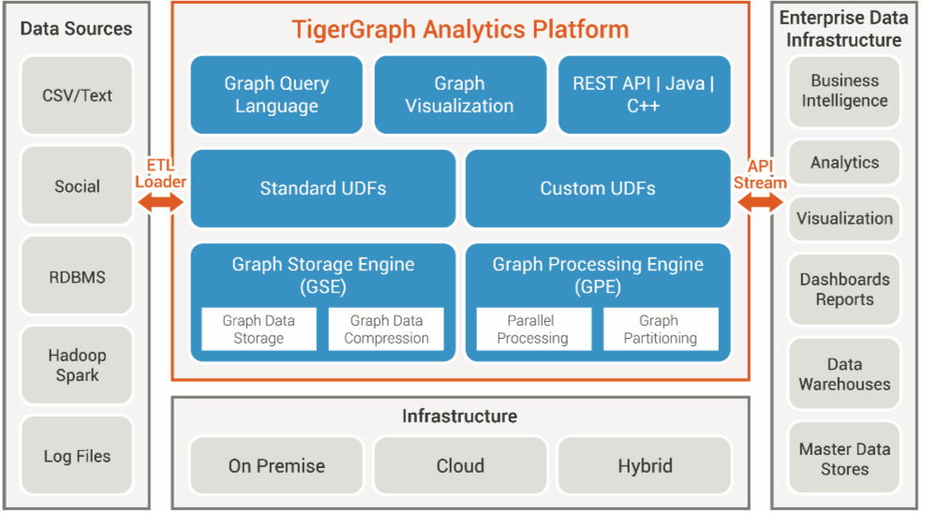
TigerGraph Architecture
Built-ins

Slide 74
GSQL Script With A Parameter
Seeding a vertex set
CREATE QUERY CountGender(String gender) FOR GRAPH OptumExample {
patients = {Patient.*};
genderPatients = SELECT p FROM patients:p WHERE patients.Gender == gender;
PRINT "Patients with gender " + gender;
PRINT genderPatients.size();
RETURN;
}
Reduced result which is the count of all patients of this gender
A one hop SELECT traversal

Slide 75
Sample GSQL Query for Degree
CREATE QUERY VertexDegreeExample(INT upperbound) FOR GRAPH OptumExample {
GroupByAccum<VERTEX<Patient> p, STRING name, SumAccum<INT> visitCount> @@patientVisit;
MinAccum<INT> @@fewestVisits;
MaxAccum<INT> @@mostVisits;
AvgAccum @@avgVisits;
patients = {Patient.*};
tmp = SELECT p
FROM patients:p - (patientVisit:e) -> Visit:v
ACCUM @@patientVisit += (p, p.FirstName + " " + p.LastName -> p.outdegree()),
@@fewestVisits += p.outdegree(),
@@mostVisits += p.outdegree(),
@@avgVisits += p.outdegree();
FOREACH patient IN @@patientVisit DO
PRINT patient.name + " had " + to_string(patient.visitCount) + " visits.";
END;
FOREACH patient IN @@patientVisit DO
IF patient.visitCount <= upperbound THEN
PRINT patient.name + " had " + to_string(patient.visitCount) + " visits.";
END;
END;
PRINT "Most Visits:" + to_string(@@mostVisits) +
" Fewest Visits:" + to_string(@@fewestVisits) +
" Avg Visits:" + to_string(@@avgVisits);
}

Slide 76
Sample Part 1
CREATE QUERY VertexDegreeExample(INT upperbound) FOR GRAPH OptumExample {
GroupByAccum<VERTEX<Patient> p, STRING name, SumAccum<INT> visitCount> @@patientVisit;
MinAccum<INT> @@fewestVisits;
MaxAccum<INT> @@mostVisits;
AvgAccum @@avgVisits;

Slide 77
Vertex Set Seed and Select Loop with Accumlators
patients = {Patient.*};
tmp = SELECT p FROM patients:p - (patientVisit:e) -> Visit:v
ACCUM @@patientVisit += (p, p.FirstName + " " + p.LastName -> p.outdegree()),
@@fewestVisits += p.outdegree(),
@@mostVisits += p.outdegree(),
@@avgVisits += p.outdegree();

Slide 78
Sample Loops
FOREACH patient IN @@patientVisit DO
PRINT patient.name + " had " + to_string(patient.visitCount) + " visits.";
END;
FOREACH patient IN @@patientVisit DO
IF patient.visitCount <= upperbound THEN
PRINT patient.name + " had " + to_string(patient.visitCount) + " visits.";
END;
END;

Slide 79
Query Results
Most Visits: 1,185
Fewest Visits: 21
Avg Visits: 166.262

Slide 80
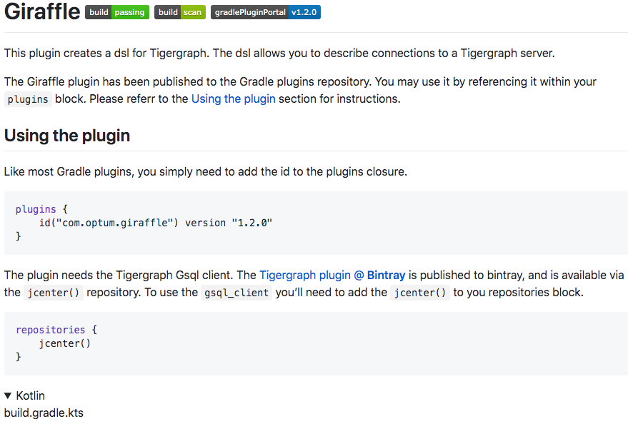
Giraffle
A declarative domain specific language (DSL) for TigerGraph build scripts
Implemented as a gradle plugin
Registered as a gradle plugin
Fewest lines of code to create reproduceable build processes
Automatically downloads GSQL client libraries
Uses Kotlin for strong type checking
Used extensively within Optum
Open sourced by Optum
http:github.com/Optum/giraffle

Slide 81
Why Gradle?
Gradle allows us to remove configuration from our code.
Configuration elements become “properties” within Gradle.
Gradle offers several mechanisms for property injection, making it ideal for workflow automation.
Gradle computes a task dependency graph, ensure tasks with dependencies occur in the proper

Slide 82
Automated Deployment to All Environments
Task List
Create database schema
Create load job
Run load job
Validate load
Run GSQL queries
Common
Properties
gradle-test.properties
gradle-stage.properties
gradle-prod.properties
gradle-local.properties
LOCAL
TEST
STAGE
PROD
A single deployment script to many environments – properties files for each environment
Tracks all tasks and dependencies

Slide 83
Getting Started
Plugin name and version
build.gradle.kts
plugins {
id("com.optum.giraffle") version "1.2.0"
}
repositories {
jcenter()
}
Repository location
Create a new directory in your workspace called ”giraffle-test”
Add the file above
“cd” to that directory and type “gradle tasks”
This will download all the appropriate binaries from the gradle jcenter repository

Slide 84
Gradle Properties Plugin
id(“net.saliman.properties”) version “1.5.1”
This allows us to store and access standard Java .properties files to provide easy default conventions for properties

Slide 85
Gradle Tasks Output
$ gradle tasks
> Configure project :
GSQL Plugin successfully applied to giraffle-test
> Task :tasks
------------------------------------------------------------
Tasks runnable from root project
------------------------------------------------------------
Build tasks
-----------
gsqlCopySources - Copy gsql scripts from input directory to build directory prior to execution.
Build Setup tasks
-----------------
init - Initializes a new Gradle build.
wrapper - Generates Gradle wrapper files.
GSQL Interactive tasks
----------------------
gsqlShell - Run an interactive gsql shell session
GSQL Project Wizard tasks
-------------------------
gsqlNewProject - Create scaffolding for new project

Slide 86
Sample dependancies and task
import com.optum.giraffle.tasks.GsqlTask
plugins { id("com.optum.giraffle") version "1.2.0" // <1> }
repositories { jcenter() }
dependencies { gsqlRuntime("com.tigergraph.client:gsql_client:2.3.2.1") }
tigergraph {
scriptDir.set(file("db_scripts"))
tokens.set(emptyMap())
serverName.set("")
userName.set("")
password.set("")
adminUserName.set("")
adminPassword.set("")
}
tasks.create("createSchema") {
dependsOn("dropSchema")
scriptPath = "schema.gsql”
}

Slide 87
Sample local properties file
gradle-local.properties
gsqlHost=localhost
gsqlUserName=tigergraph
gsqlPassword=tigergraph
gsqlAdminUserName=tigergraph
gsqlAdminPassword=tigergraph
Never check your gradle-local.properties into git. Use the .gitignore file to avoid checking it in.

Slide 88
Sample Graph Traversal Patterns
Dependencies
Failure chains
Order of operations
Clustering
Finding related items
Friends, fraud networks
Similarity
Similar paths and patterns
API
Server
Auth
Data
Matching/Categorizing
Look for and tag specific patterns
Flow/Cost
Optimize costs based on routing
Path optimization
Centrality/Search
Which nodes are the most connected or relevant?
Notes:
Dan

Slide 89
Item Similarity
Target
Population
Used to find the most similar items in a graph by comparing properties
Ideal when you a can compare individual features of an item numerically
Algorithms return a ranking of similarity between a target an a population

Slide 90
Vector Similarity
last
y
Target
1st
Population
x
Vectors are similar in two dimensional space if they have the same length and direction
Compare all the “x” lengths and the “y” lengths and rank by the sum of the totals of the difference

Slide 91
Vector Representation
x=8
y=10
16
16
8
6
4
3
7
9
-4
6
-4
6
-12
-8
Target Vector
Population Vectors
Each item can be represented by a series of “feature” vectors
The numbers are scalers

Slide 92
Cosine Used in Comparing Direction
a
b
The dot product of two vectors a and b (sometimes called the inner product, or, since its result is a scalar, the scalar product) is denoted by a ∙ b and is defined as:
If the lines are exactly in the same direction, then theta is 0, cos(0) = 1
If the lines are 90 or -90 degrees apart they are in orthogonal directions cos(90) = 0

Slide 93
“Patients Like Me”
Target Patient Graph
Cohort Sample Population Vectors
Key Features
Gender
Age
CohortCode1
CohortCode2
Condition1
Condition2
Disease1
Disease2
Drug1
Drug2
Gene1
Gene2
Gender
Age
CohortCode1
CohortCode2
Condition1
Condition2
Disease1
Disease2
Drug1
Drug2
Gene1
Gene2
Gender
Age
CohortCode1
CohortCode2
Condition1
Condition2
Disease1
Disease2
Drug1
Drug2
Gene1
Gene2
Gender
Age
CohortCode1
CohortCode2
Condition1
Condition2
Disease1
Disease2
Drug1
Drug2
Gene1
Gene2
Cosine similarity
Demographics
Conditions
Extract
Genes
IoT
Similarity Score:
80
89
92
Graph Similarity algorithms allows graph databases to quickly compare current items with many other items
For any given patient, we can use a fast, in-memory similarity algorithm to compare the key features of any patients to a larger population
Cohort codes can be pre-calculated to quickly narrow the sample population to a smaller group
This calculation is considered a “embarrassingly parallel” query and could be accelerated by adding more nodes to a cluster
Specialized graph hardware is coming (Graphcore)

Slide 94
Example: Patients Like Me
Other
Patients
Other
Patients
Patient
Patient Vector
age=82
gender=F
claimCount=47
prescriptions=6
82
1
47
7
75
2
63
2
Demographics
Conditions
Age
Prescriptions
Gender
Allergies
Race
Genetics
IoT Data
Given a target patient, find the most similar patients

Slide 95

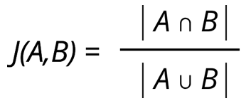

Jaccard Similarity
Measures the similarity or relative overlap between two sets of data by dividing the size of the intersection by the size of the union
The range of scores is from 0 - 1 where 1 is identical
Sets of data can be created through a graph using attributes from vertices and edges
This can be run with a single source or on all pairs. Running it on all pairs would be inefficient for a large, dense graph

Slide 96
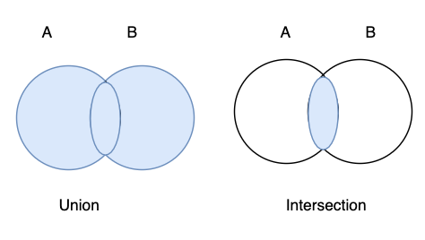
Jaccard Similarity Use Case
For example both John Doe and Jane Doe have been diagnosed with the same disease, comparing their age, race, ethnicity and gender, how similar are these individuals?
Let John Doe be set A = { 35, “White”, “Italian”, M}
Let Jane Doe be set B = { 35, “White”, “French”, F }
A ∩ B = { 35, “White” }
A ∪ B = { 35, “White”, “Italian”, “French”, M, F }
|A ∩ B| = 2
|A ∪ B| = 6
Similarity(A, B) = 2 / 6 = .333
The magnitude of the union of sets A & B divided by the magnitude of the intersection of sets A & B.

Slide 97
Graph Performance
For benchmarks see https://graph500.org
Graph Size # Verticies (log scale)
Cray Graph Engine
Datavortex
Graphcore?
1T
Largest
Supercomputer
100B
TigerGraph 2.2
(distributed graph)
10B
1B
Neo4j 3.4
(single node)
100M
RDBMS
10M
.001
.01
.1
1
10
100
1K
10K
GTEPS - Billion Traversed Edges Per Second (log scale)

Slide 98
Optum Graph High Level Architecture
Data
Access APIs
Staging Graph
Production Graph
Source Systems
User
Interface
Dashboards
Agents
Data
Lake
Data Flows Similar to any Data Warehouse

Slide 99

Explainable AI Models Leverage Graphs
Today
Task
Why did you do that?
Why not something else?
When do you succeed?
When do you fail?
When can I trust you?
How to I correct an error?
Training
Data
Machine
Learning
Process
Learned
Function
Decision or Recommendation
Explainable AI
Task
I understand why
I understand why not
I know when you succeed
I know when you fail
I know when to trust you
I know why you erred
Training
Data
New
Machine
Learning
Process
Explanation
Interface
Explainable Model
https://www.darpa.mil/program/explainable-artificial-intelligence
Notes:
Explainable AI is a key
https://www.darpa.mil/program/explainable-artificial-intelligence

Slide 100

Three Eras of Computing
1) Procedural Era
Data
Programs
Answers
Procedural Code (Rules)
Explanations (Why)
2) Machine Learning Era
Data
Machine
Learning
Rules (10M weights)
Answers
3) Graph Era
Data
Knowledge
Answers
Machine
Learning
Explanations (Why)

Slide 101
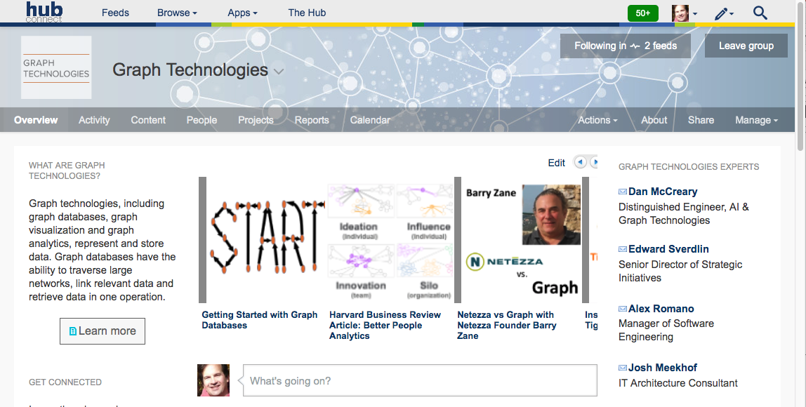
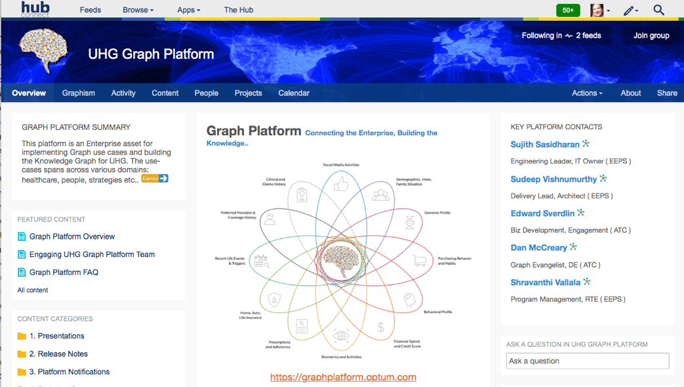

Graph Technologies and Graph Platform on The Hub
ATC Graph Technologies
General site about graph technologies
How to get started
Training
Market analysis
Vendor perspectives
Links to demos and videos
EEPS UHG Graph Platform
Part of the Healthcare Platform
What is in the Knowledge Graph
https://hubconnect.uhg.com/groups/graph-databases
https://hubconnect.uhg.com/groups/uhg-graph-platform

Slide 102
Learn More
Graph UI Demos http://graph.optum.com
Graph, ontologies and NLP http://umls.optum.com
MOVE Graph initiatives
Strategy Graphs
Enterprise People Fabric – graph to support human capital analytics
Flowdock Graph Technologies
GSQL 101 Tutorial
OTU Courses
Graph Modeling
Graph Algorithms
Graph Visualization

Slide 103
Thank you!
Dan McCreary, Dan.McCreary@optum.com
Sudeep Vishnumurthy, Sudeep.Vishnumurthy@optum.com
Josh Meekhof, Josh_Meekhof@optum.com
Special thanks to
Optum Tech University
Paul Malley – Knowledge and Learning
Paolo Dominguez – OTU
Andrew Han – Docker Configuration
Sathyamoorthy Sivaperuman – Docker
Richard Seibert – Docker Configuration Consulting
Ranjan Prasad - Docker Support Owner
Scott Mackay – Docker Help
Ramakanth Pandari – Docker Product Owner
Christopher Moy – Docker Testing on Windows 10
Daniel Binkley – Docker Testing
Tyler Macdowell – Docker Testing
Chris Rothwell – Docker Testing

